Slide 1
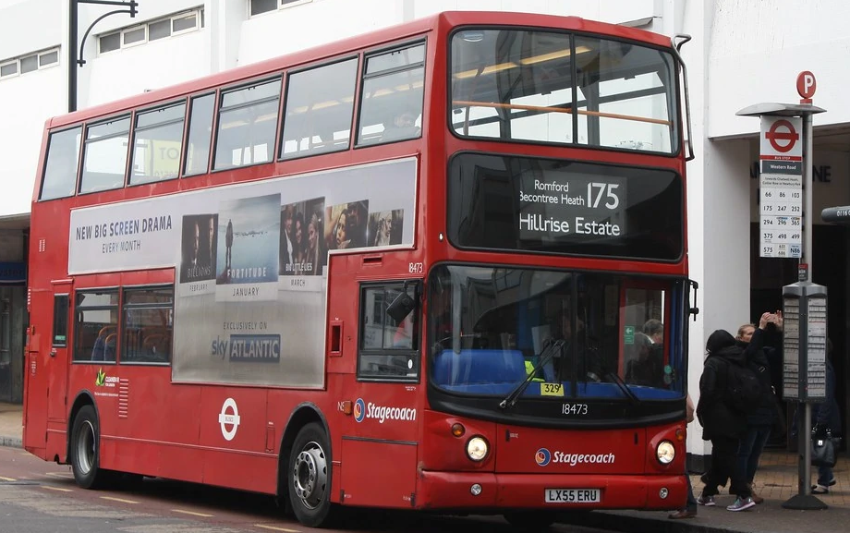
Transport Timetables

Slide 2
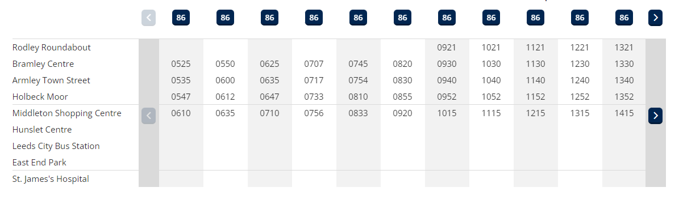
Bus Timetables
Which bus will get me to Middleton BEFORE 8:30 am?
I need to be at Middleton Shopping Centre before 8:30.
What is the latest bus I can catch from Armley Town Street to get there on time?

Slide 3
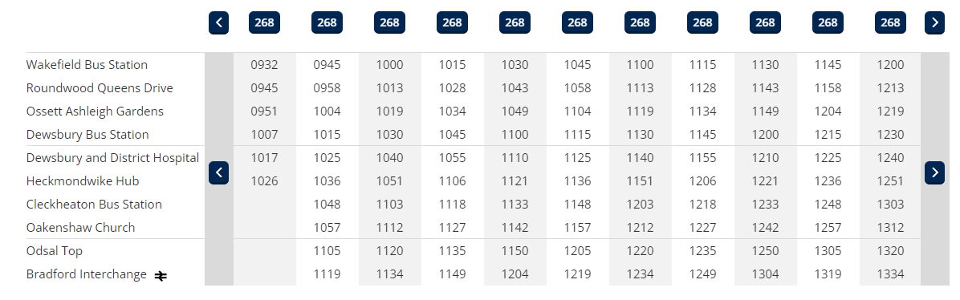
I need to get to the ground for 12:40 so that I can get to my seat in time for kick off.
I want to watch Bradford Bulls play at Odsal Top. The match kicks off at 1pm and I will need 20 minutes to get to my place in the stand. Which is the latest bus I can catch to get there from Dewsbury and District Hospital?

Slide 4
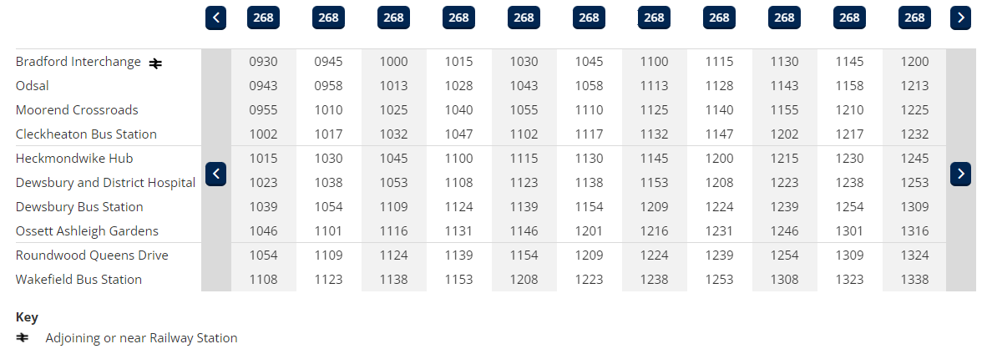
I need to get to Ossett for quarter to one or I will be late.
I’m meeting a friend in Ossett. We have arranged to meet at 1pm. I get a train to Bradford Interchange and then catch the 268 to Ossett. What is the latest bus I can catch to get to Ossett on time?

Slide 5
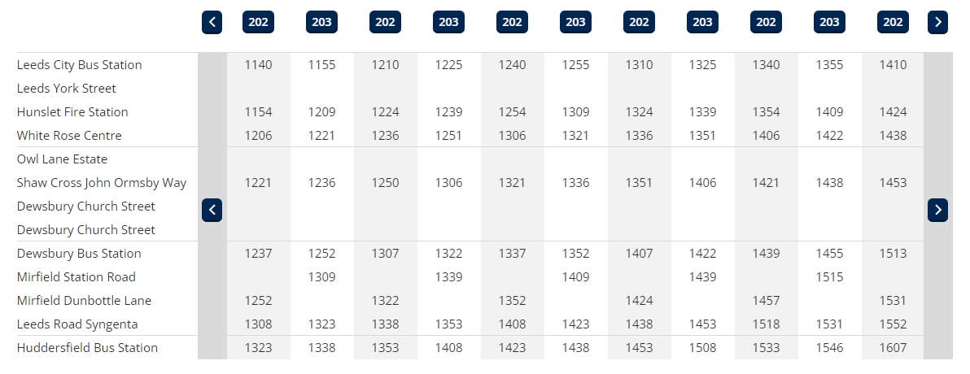
I want to arrive at Syngenta for 2.00pm so I can relax before the interview.
I have an interview at Syngenta in Huddersfield. The time of the interview is 2:30pm. I would like to get there half an hour before the interview so I can settle. What is the latest time I can catch a bus from Shaw Cross?

Slide 6
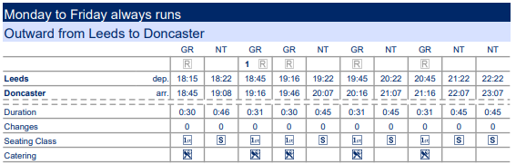
On average, how long does it take the railway train to get from Leeds to Doncaster?
$$\frac{30+46+31+30+45+31+45+31+45+45}{10}= \frac{379}{10}=37.9 minutes =37 mins 54 secs$$

Slide 7
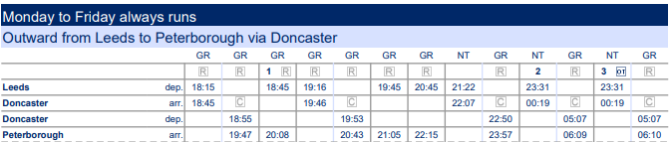
Given that is it 100 miles,what is the speed of the 18:45 train from Leeds to Peterborough?
$$\frac{Distance (miles)}{Time (minutes)}= \frac{100}{15+60+8}=\frac{100}{83} =1.204819 miles per minute=72.28916 miles per hour$$

